Slide 1

Exam Management System

Slide 2
​Our system manage work inside of an academic course between the lecturer(s) and the TAs. Through the system you will develop, test and create multiple-choice questions, generate exams and analyze them

Slide 3
motivation
With the increase in the size of the student body, it has become difficult to manage grading within the given time constraints. This has led many courses to adopt a multiple-choice format, which is faster to grade, and easier to analyze.
The creation of one-time-use questions is costly and unsustainable- We want to ease the process of creating those exams.
The creation of challenging multiple-choice questions is not a trivial task.

Slide 4
The solution
A web-based System for managing the course growing pool of questions.
help you manage creating future questions
1
analyze the questions quality
2
create an exam based on analysis of the questions
3

Slide 5


Slide 6
roles
System Administrator:
Create courses
Delete courses
Can view the GPA of the courses
Course Administrator:
Assign course staff
Define the course’s exam parameters
Generates exams
TA:
creation and validation of questions, stems, keys, distractors, and solutions.
Grader:
Add a student solution to an existing exam.

Slide 7
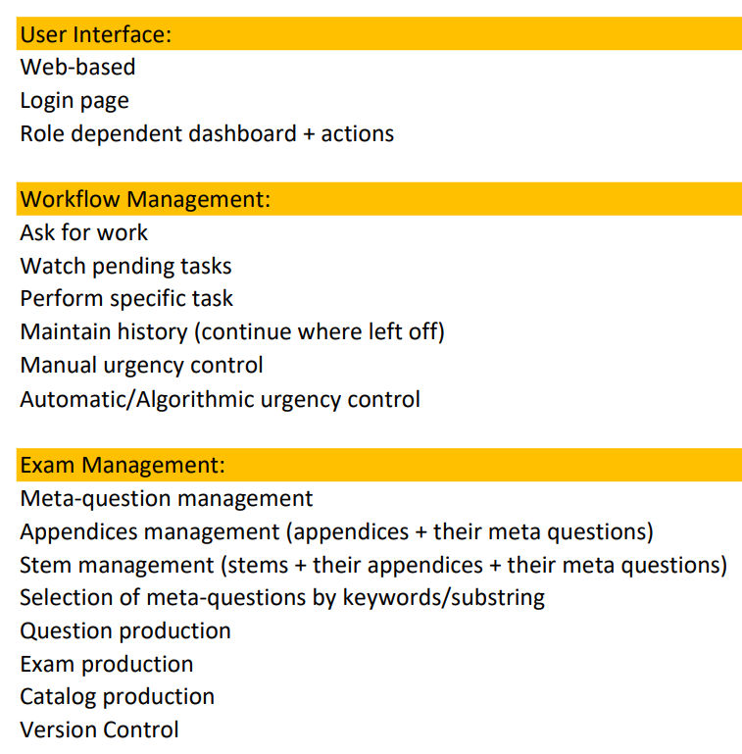
Project’s Steps and Timeline
Semester A
1 month
User interface (shell)
2 month
Workflow management
2 month
Testing
Semester B
3 month
Workflow management
2 month
E2E Testing

Slide 8
Work management flow : TA takes a task from the task pool
TA logs in to the system
Goes to the tasks page (which represents all possible tasks which are not assigned)
He chooses a task and assign it to himself
The task is moves to the TA backlog
The task is removed from the tasks page

Slide 9
Create exam
The course admin logs in to the system
He goes to exam page
He clicks create new exam
The exam PDF is downloaded to his computer
The new exam is saved to past exams

Slide 10
Add exam answers
Grader logs in to the system
He goes Exam page
Clicks on add answer to specific exam and choose the relevant exam
He adds the student answers *
The exam statistics and the questions statistics are renewed based on the new information
* In the future we might want to change It into scanned answers

Slide 11
Technological choices
Backend: | JavaScript
Frontend: | React
Database: | Postgress

Slide 12
Risks
User Adoption Challenges:
Example: Resistance from users to adapt to the new system.
Mitigation: Provide user documentation, and gather feedback early in the development process.
Data Security:
Example: Vulnerability to unauthorized access and leaking of sensitive information.
Mitigation: Use user authentication mechanisms to safeguard sensitive data, access will be allowed only from the university network, or by using vpn.
Web Interface:
None of the members had work as a web developmet
Mitigation: All members will read and study about prepared libraries (specifically risk) that will allow easy web interface development

Slide 13
Proof Of Concept

Slide 14
Research:
Examination of Web-Based Workflow Tools:
Investigate popular web-based workflow management tools.
Assess their capabilities for role-based dashboards and task distribution.
Algorithmic Task Distribution:
Research and develop a preliminary algorithm for task distribution

Slide 15
Preliminary:
Selection of Web-Based Framework:
Based on research, choose a web-based framework suitable for developing the workflow management system.
Basic UI Development:
Implement basic UI features, such as role-based dashboards and content organization.
Integrate a simple manual task assignment mechanism.

Slide 16
System Implementation:
Workflow management:
Implement a simplified version of the workflow management system
LaTeX-Based Exam Creation and analysis :
Develop a module for flexible LaTeX-based exam, key, and solution creation.
Database Integration:
Establish basic database integration for handling workflow and content data.

Slide 17
Example of how it looks

Slide 18
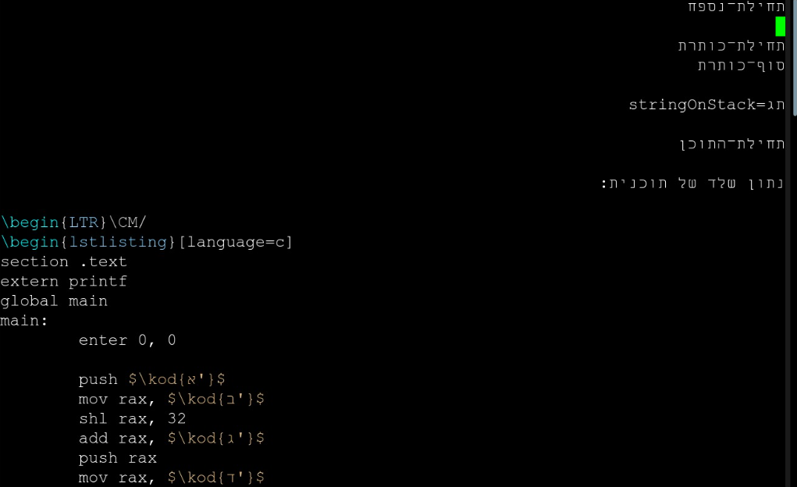
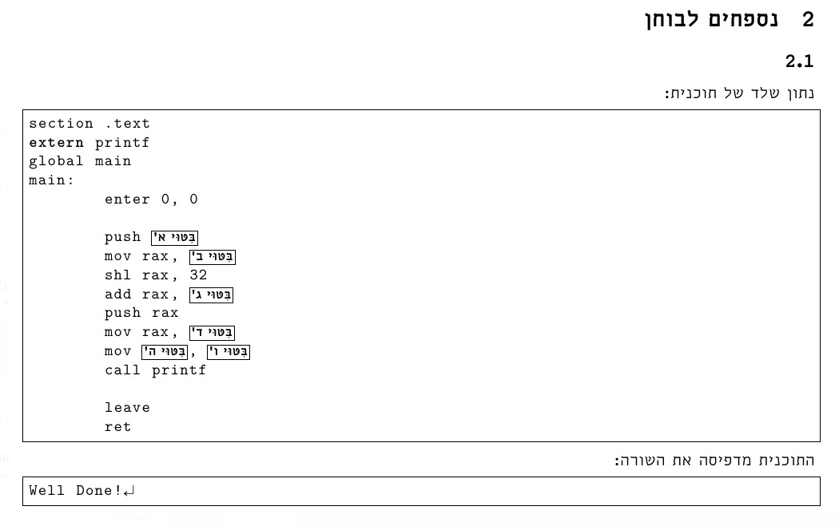
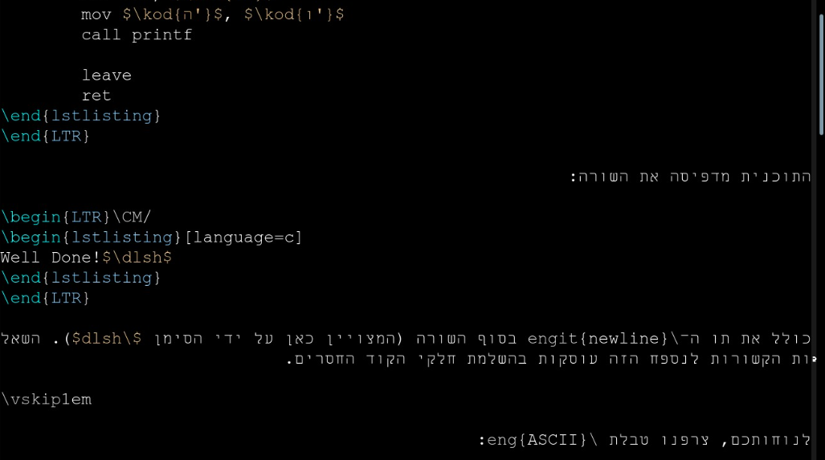
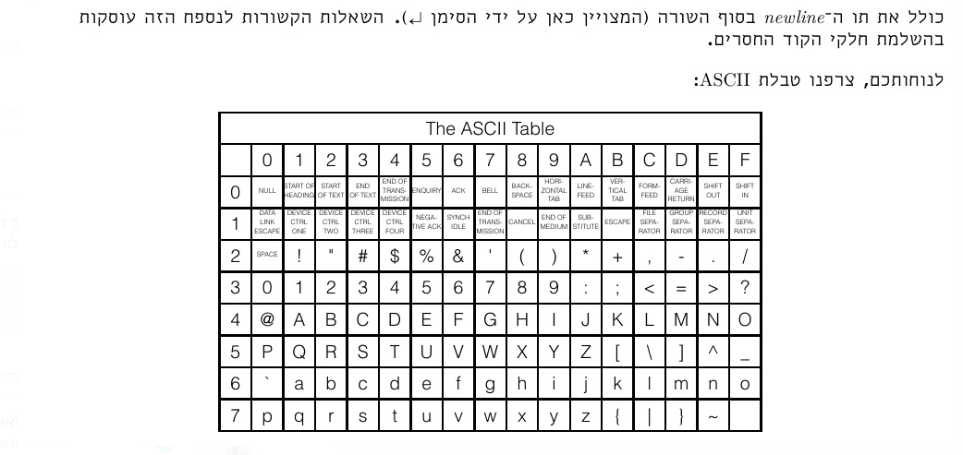
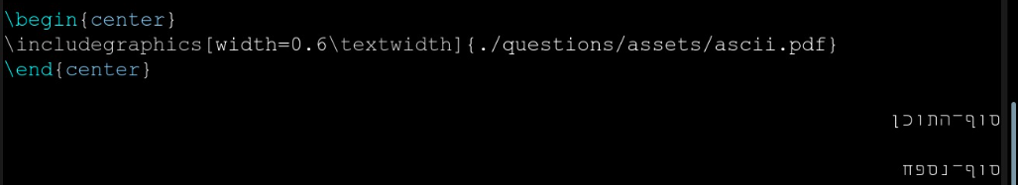

Slide 19
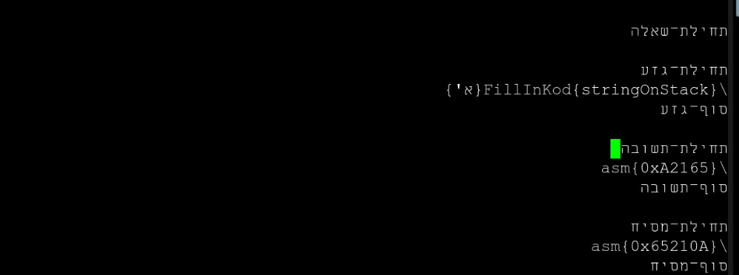
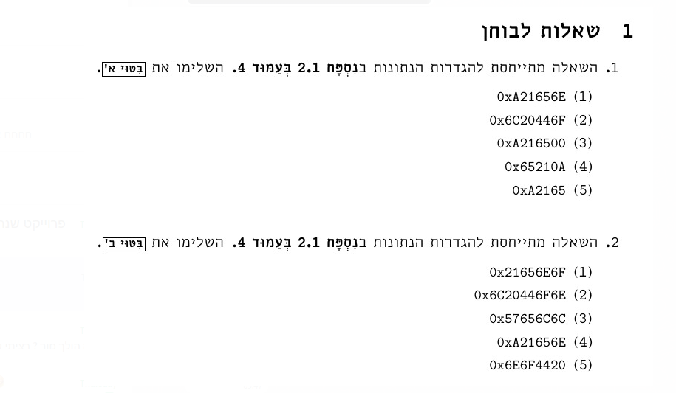
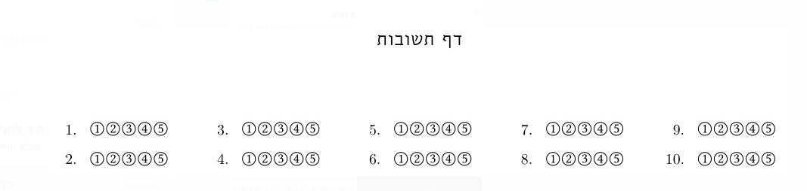
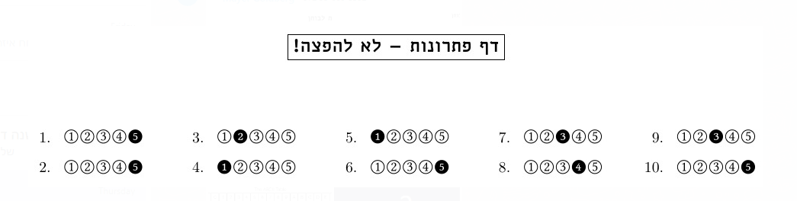
…

Slide 20
Gantt

Slide 21
Example of how it looks

Slide 22
Where are we now?
Started learning JS and react
We have agreed on the design of the backend
We created a preliminary server with just a login option

